Slide 1
Day 3

Slide 2
Exploratory Data Analysis (EDA)
For Time Series Analysis

Slide 3
Introduction to EDA
Exploratory Data Analysis (EDA) is a process of analyzing and summarize the data in statistical and visualization way.
EDA is important step so that we can gain insights from the data and detect the strange anomalies of time series data such as outliers.
EDA usually composed of two ways, graphical or non-graphical and univariate and multivariate.
Notes:
Useful reading: https://towardsai.net/p/data-analysis/exploratory-data-analysis-in-python-ebdf643a33f6

Slide 4
Anomalies in Time Series Data
Anomalies also known as outliers in time series data is observations that don’t follow the expected behavior.
Outliers often treated as noises in time series data and should be deleted or corrected to improve data quality and generate a cleaner dataset.
However, in recent years many researchers have aimed to detect and analyze unusual, but interesting phenomena of these outliers
How to detect outliers in time series data?
STL decomposition
Histogram
Boxplot IQR (Interquartile range)
Z-score (Standard Normal Distribution)
Outliers in time series can have two different meanings as describe in figure in the next slide

Slide 5
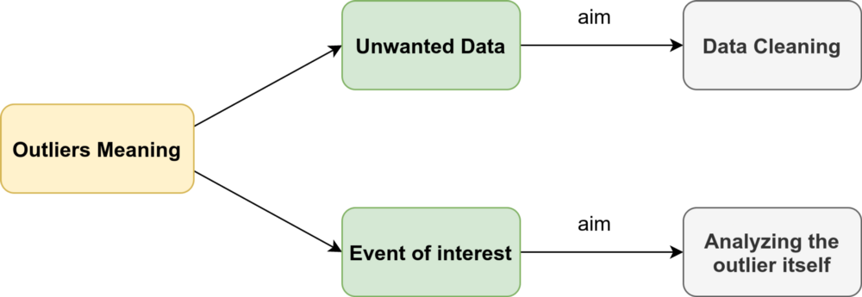

Slide 6
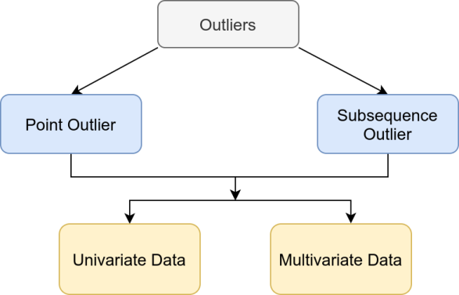
Type of outliers

Slide 7
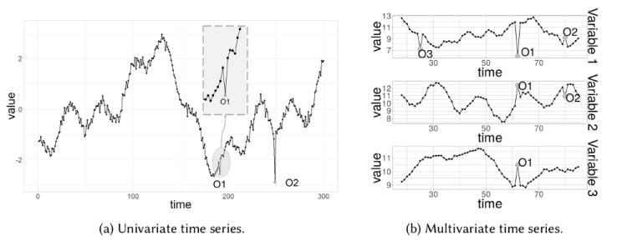
Point Outlier
A point outlier is a datum that behaves unusually in a specific time instance when compared either to the other values in the time series (global outlier), or to its neighboring points (local outlier).
Fig. 1a contains two univariate point outliers, O1 and O2, whereas the multivariate time series is composed of three variables in Fig. 3b, and has both univariate (O3) and multivariate (O1 and O2) point outliers.

Slide 8
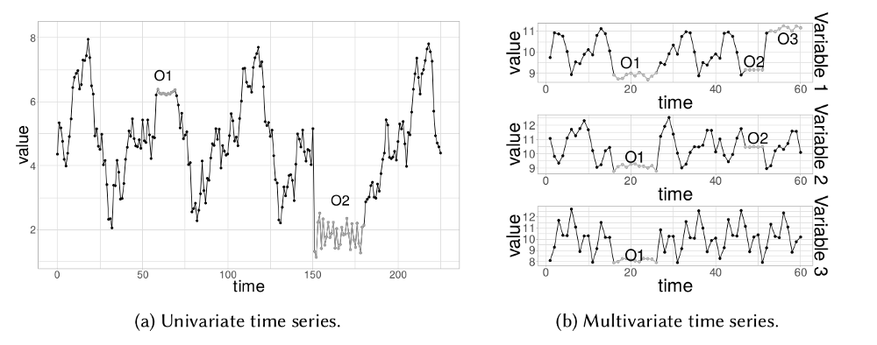
Subsequence outlier
This means consecutive points in time whose joint behavior is unusual, although each observation individually is not necessarily a point outlier. Subsequence outliers can also be global or local, and can affect one (univariate subsequence outlier) or more (multivariate subsequence outlier) time-dependent variables.
Fig. 2 provides an example of univariate (O1 and O2 in Fig. 2a, and O3 in Fig. 2b) and multivariate (O1 and O2 in Fig. 2b) subsequence outliers. Note that the latter does not necessarily affect all the variables (e.g., O2 in Fig. 2b).

Slide 9
STL decomposition
STL stands for seasonal-trend decomposition.
This technique gives you the ability to split your time series signal into three parts: seasonal, trend, and residue.
Take a look at figure below, after we compute the STL, we can see that using residual data from decomposition, we’ll get an anomaly detection algorithm.
Notes:
https://neptune.ai/blog/anomaly-detection-in-time-series

Slide 10
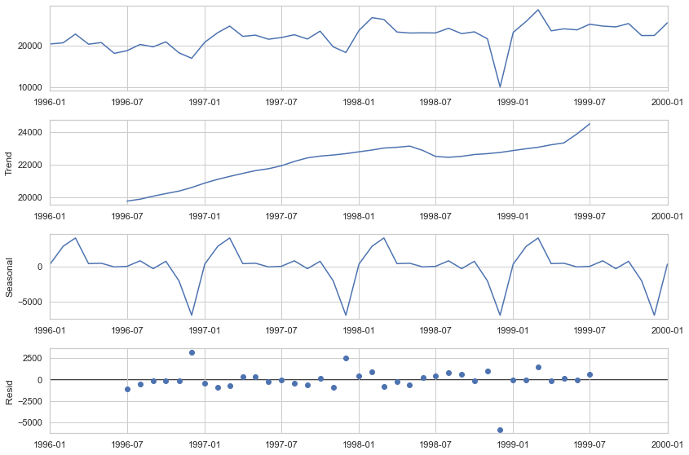
Time-series components
Anomalies/
outliers
Notes:
https://neptune.ai/blog/time-series-prediction-vs-machine-learning

Slide 11
Time-series crucial components
Trend:
Time-series data shows a trend when its value variably changes with time, an increasing value shows a positive trend and decreasing, a negative trend. I
Seasonality:
Seasonality refers to a property of time-series that displays periodical patterns repeating at a constant frequency. months.
Remainder:
After extracting Trend and Seasonality from the data, the remaining is what we call remainder (error) or Residual. This actually helps in anomaly detection in time-series.
Cycle:
Time-series data is termed cyclical when there are trends with no set repetitions or seasonality.
Stationarity:
Time-series data is stationary when its statistical features do not change over time i.e. a constant mean and standard deviation. The covariance is independent of time.

Slide 12
Boxplot IQR (Interquartile range)
Interquartile range method
Sort your data from low to high
Identify the first quartile (Q1), the median, and the third quartile (Q3).
Calculate IQR = Q3 – Q1
Calculate upper fence = Q3 + (1.5 * IQR)
Calculate lower fence = Q1 – (1.5 * IQR)
Use your fences to highlight any outliers, all values that fall outside your fences.
Your outliers are any values greater than your upper fence or less than your lower fence.

Slide 13
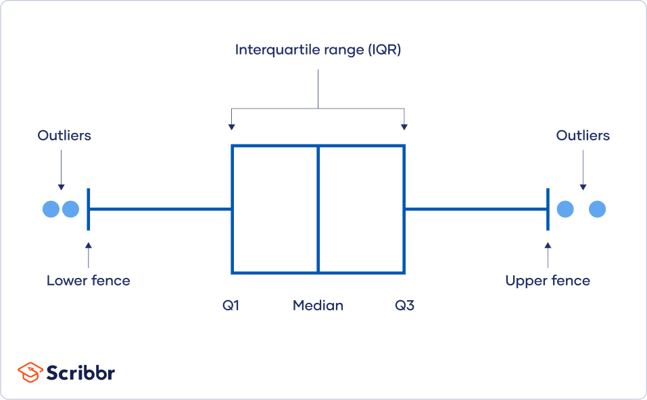

Slide 14
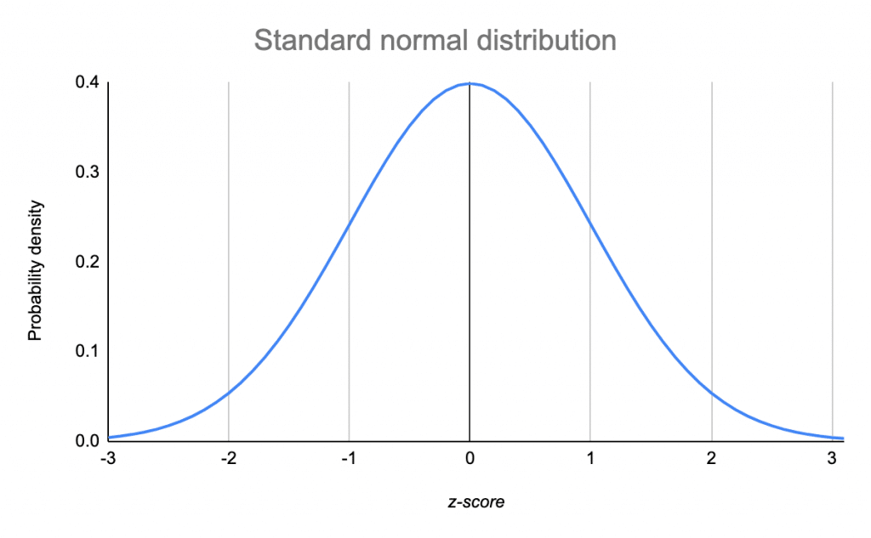
Z-score (Standard Normal Distribution)
You can convert extreme data points into z scores that tell you how many standard deviations away they are from the mean.
If a value has a high enough or low enough z score, it can be considered an outlier.
As a rule of thumb, values with a z score greater than 3 or less than –3 are often determined to be outliers.

Slide 15
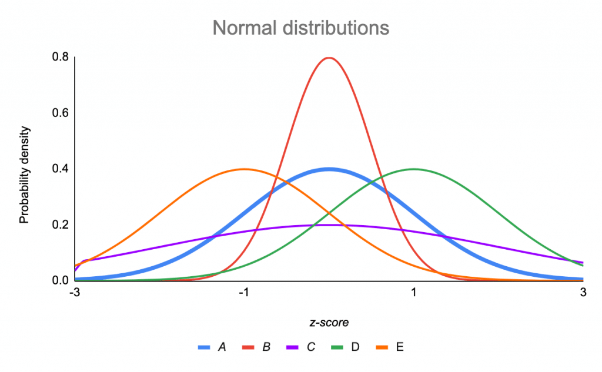
Curve | Position or shape (relative to standard normal distribution)
A (M = 0, SD = 1) | Standard normal distribution
B (M = 0, SD = 0.5) | Squeezed, because SD < 1
C (M = 0, SD = 2) | Stretched, because SD > 1
D (M = 1, SD = 1) | Shifted right, because M > 0
E (M = –1, SD = 1) | Shifted left, because M < 0

Slide 16
Handling missing data
Missing value presents many problems in the dataset.
It reduces the statistical power of data, and the lost data can increase the bias in the dataset.
It is essential to handle this missing value to maintain the characteristics of the data
There are two types of data its either quantitative (numerical data) and qualitative (categorical data)
To handle these two types of data require different approach. Let see how this can be done.

Slide 17
Quantitative data
Discrete data
Involves whole number (integers) that can't be divided based on the nature of what they are
Example: number of people in class, age etc
Continuous data
Involves decimal point values and can be divided up as much as you wants
Example: weight, height etc

Slide 18
Qualitative data
Nominal data
Nominal data are used to label variables without any quantitative value.
Example: Male/female, Malaysian/American etc
Ordinal data
Values that is ordinal or in orderly manner often has scales to it
Example: Very Likely, Likely, Neutral, Unlikely, Very Unlikely

Slide 19
Methods to Handle Missing data
Statistical Method
Mean, Mode and Median
Linear regression Method
Back-fill - based on the last observation
Forward-fill - based on the forward observation
Interpolation Method (i.e: linear, quadratic, nearest)
Algorithm (i.e: KNN, random forest, XGboost and so on)
How about categorical data? Can you think of one solution to handle these missing data?

Slide 20
Data Normalization
Normalization is generally required when we are dealing with attributes on a different scale, otherwise, it may lead to a dilution in effectiveness of an important equally important attribute (on lower scale) because of other attribute having values on larger scale.
Techniques of normalization:-
Decimal Scaling
Min-Max Normalization
z-Score Normalization (zero-mean Normalization)

Slide 21
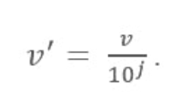
Decimal Scaling
Normalize by moving the decimal point of values of the data. To normalize the data by this technique, we divide each value of the data by the maximum absolute value of data

Slide 22
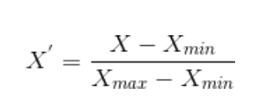
Min Max Normalization
Min Max Normalization is a scaling technique in which values are shifted and rescaled so that they end up ranging between 0 and 1
Scaling to a range is a good choice when both of the following conditions are met:
You know the approximate upper and lower bounds on your data with few or no outliers.
Your data is approximately uniformly distributed across that range.

Slide 23
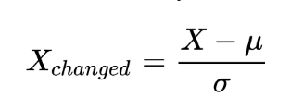
Z-score Normalization/standardization
Z-score is a variation of scaling that represents the number of standard deviations away from the mean.
z-score ensure your feature distributions have mean = 0 and std = 1
It’s useful when feature distribution does not contain extreme outliers.

Slide 24
Resampling Time Series Data
In time series, data consistency is essential.
Resampling ensures that the data is distributed with a consistent frequency.
Resampling can also provide a different perception of looking at the data, in other words, it can add additional insights about the data based on the resampling frequency.
The two popular methods of resampling in time series are as follows:-
Upsampling
Downsampling

Slide 25
Important Keys Takeaways…
EDA is important steps before model training to gain insights from the data and detect the strange anomalies of time series data.
These outliers sometimes is just a noise to the data but it also can be important information in data behaviour detection such pattern and trend.
We usually need to investigate these anomalies first before decided to get rid or to treat these anomalies with suitable methods. Getting rid of these anomalies may impact the originality of the data
We can make use of STL decomposition, boxplot or z-score methods to detect these outliers
Once we found the outliers we have to decide what to do with these outliers because it will affect our model learning. Remember model learn by the data we feed to it.
Data normalization is common technique to treat the outliers as it makes your data more consistent. You can use decimal scaling, z-score or min max normalization depending on your use cases.
Handling missing values are also important and there are several techniques you can implement to fill in these missing rows
Data resampling is also important part for time series analysis as it is a crucial variable that shows how the data adjusts over the course of the data points as well as the final results.

Slide 26
Example Walkthrough

Slide 27
Workflow Example - EDA Overview
This workflow used dataset from kaggle website.
The dataset is a collection of Earth Surface Temperature Data from year 1750 to 2015.
In this dataset, there are :-
Global Land and Ocean-and-Land Temperatures (Global Temperatures.csv):
Date: starts in 1750 for average land temperature and 1850 for max and min land temperatures and global ocean and land temperatures
LandAverageTemperature: global average land temperature in celsius
LandAverageTemperatureUncertainty: the 95% confidence interval around the average
LandMaxTemperature: global average maximum land temperature in celsius
LandMaxTemperatureUncertainty: the 95% confidence interval around the maximum land temperature
LandMinTemperature: global average minimum land temperature in celsius
LandMinTemperatureUncertainty: the 95% confidence interval around the minimum land temperature
LandAndOceanAverageTemperature: global average land and ocean temperature in celsius
LandAndOceanAverageTemperatureUncertainty: the 95% confidence interval around the global average land and ocean temperature

Slide 28
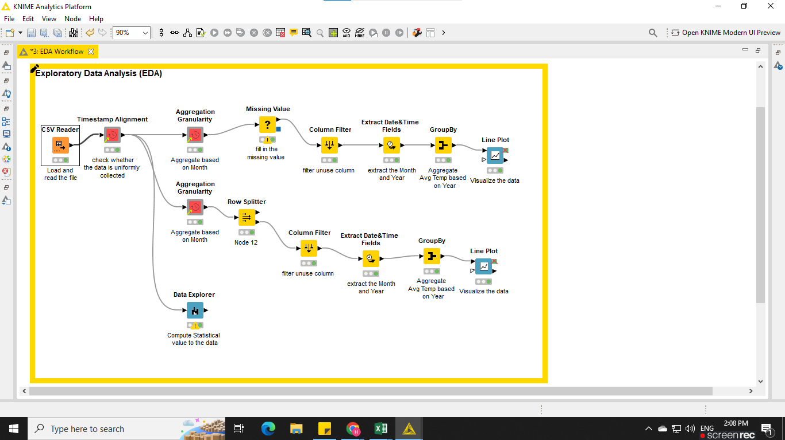
Workflow Example - EDA Overview

Slide 29

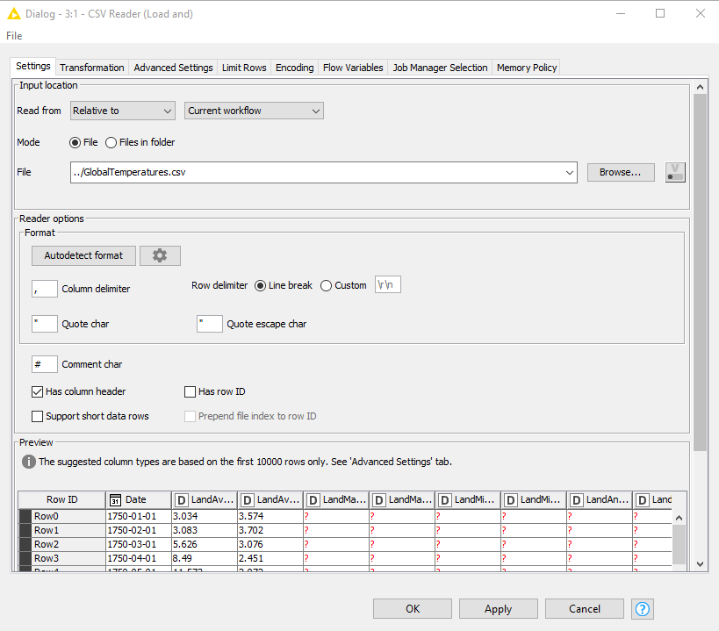
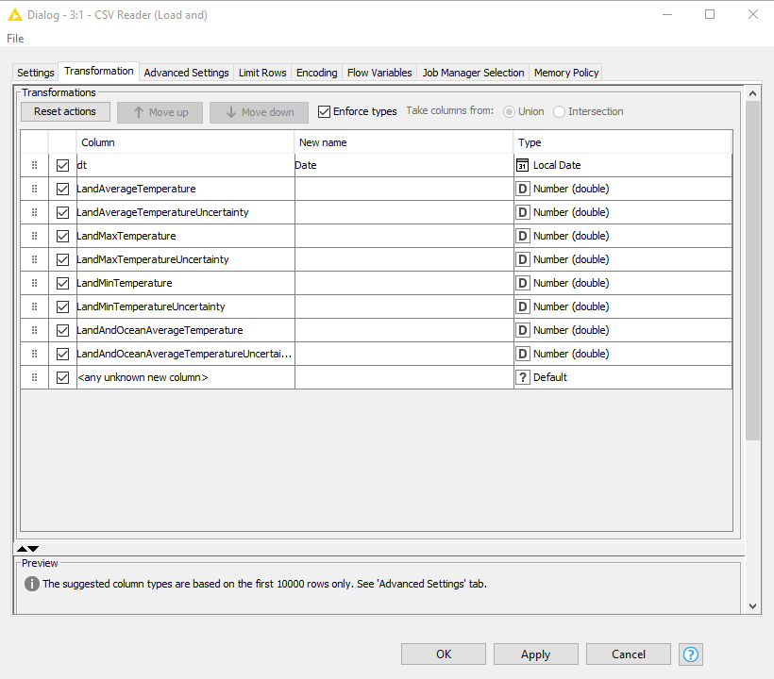
Data Loading
CSV Reader - Use this node to read CSV file. You can also transform the data table at the transform tab
Rename the column and change the data type to your convenience

Slide 30
2. Data preprocessing for Time Series Analysis
Time series analysis is a specific way of analyzing a sequence of data points collected over an interval of time.
In time series analysis, analysts record data points at consistent intervals over a set period of time rather than just recording the data points intermittently or randomly.
However, this type of analysis is not merely the act of collecting data over time.
What sets time series data apart from other data is that the analysis can show how variables change over time.
In other words, time is a crucial variable because it shows how the data adjusts over the course of the data points as well as the final results.
It provides an additional source of information and a set order of dependencies between the data.

Slide 31
2. Data preprocessing
Since that time series require to record data points at consistent intervals over a set period of time, we can make use the knime verified component for time series analysis.
Knime verified component is a collection of components that act like KNIME Node provided by KNIME to ease the users.
You can download the the components via the KNIME Hub.
There are also other knime verified component that you can explore depending on your project uses.

Slide 32
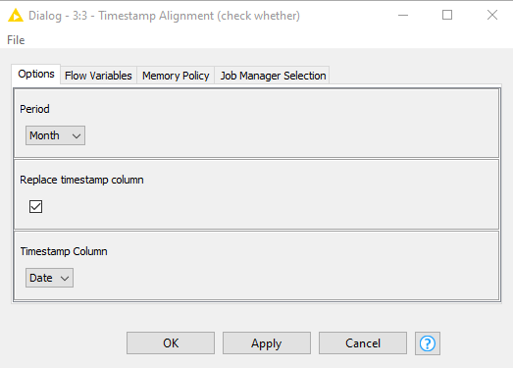
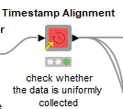
2. Data Preprocessing
Timestamp Alignment Component - checks whether the selected timestamp column is uniformly sampled in the selected time scale. Missing values will be inserted at skipped sampling times
Define by user
Define by user

Slide 33
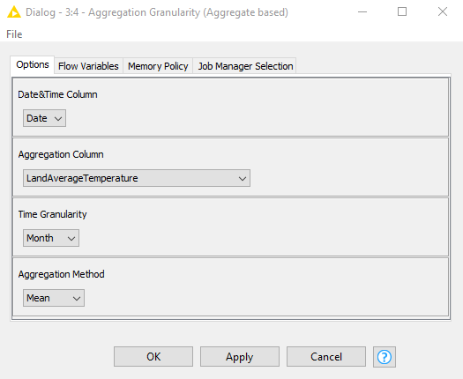
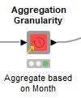
2. Data Preprocessing
Aggregation Granularity - aggregates values in a selected numeric or string column by timestamps extracted from a column of type Date&Time
Define by user
Define by user

Slide 34
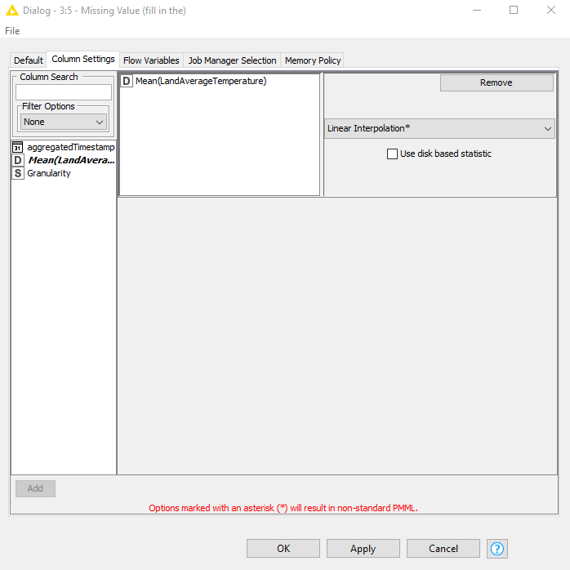

2. Data Preprocessing
Missing Value - handle missing values found in cells of the input table.
You can choose various method to fill in the missing value but for the time series it’s best to use Linear Interpolation method.
Useful reading how to handle missing values in Time Series Data

Slide 35
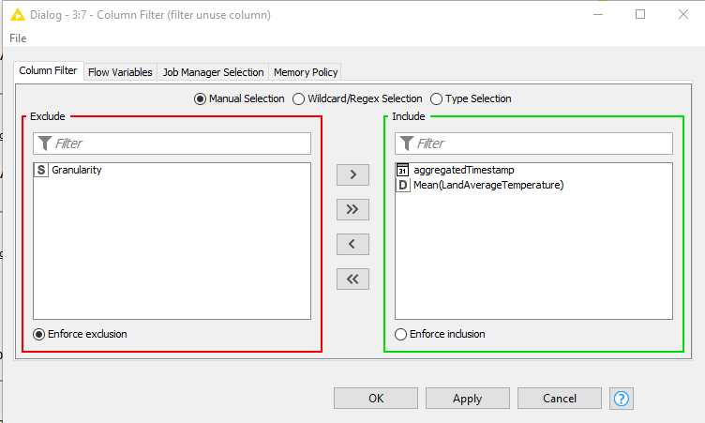
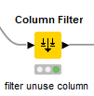
2. Data Preprocessing
Column Filter - allows columns to be filtered from the input table while only the remaining columns are passed to the output table.

Slide 36
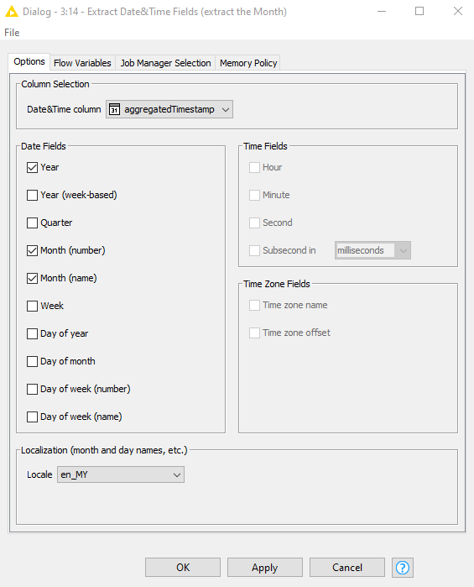
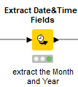
2. Data Preprocessing
Extract Date&Time Fields - Extracts the selected fields from a Local Date, Local Time, Local Date Time or Zoned Date Time column and appends their values as corresponding integer or string columns.

Slide 37
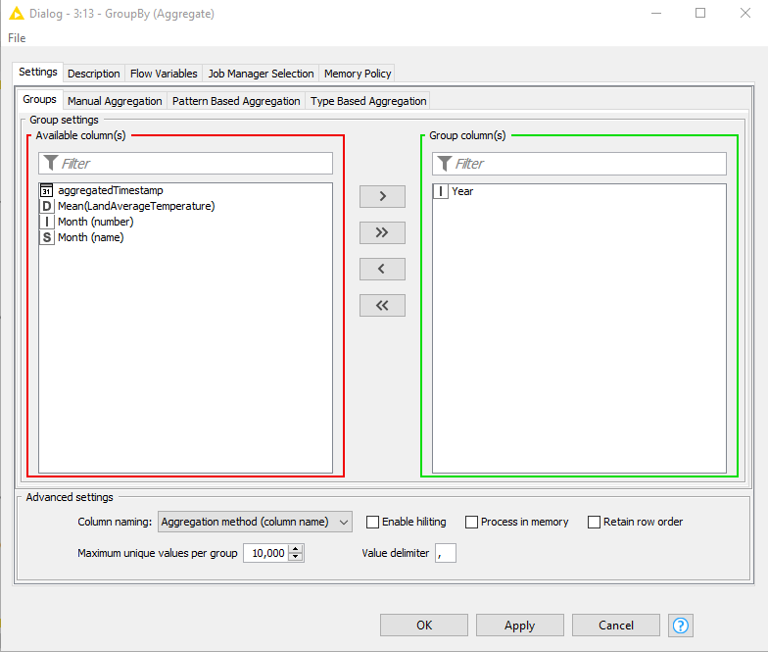
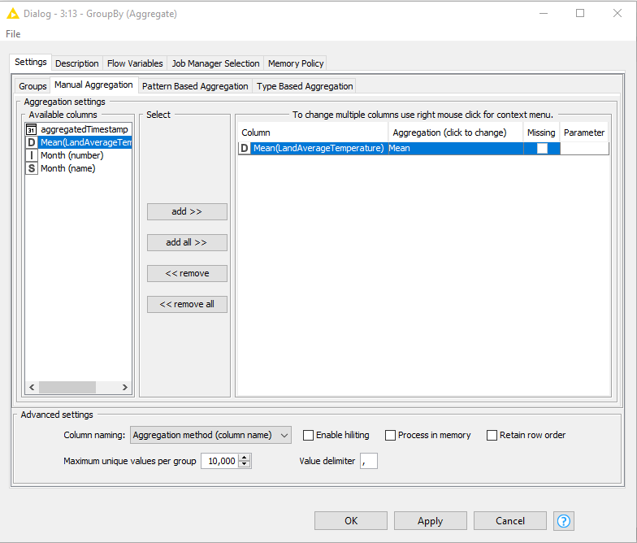

2. Data Preprocessing
GroupBy - Groups the rows of a table by the unique values in the selected group columns

Slide 38
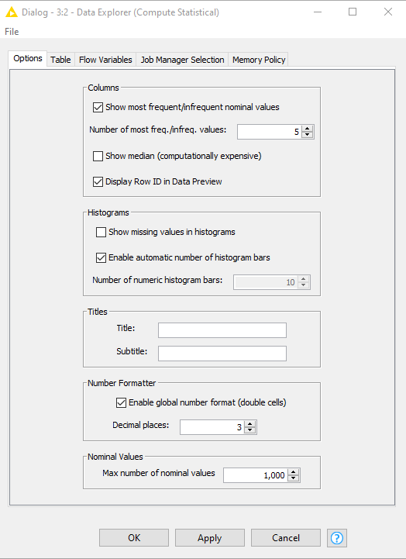
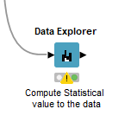
3. Data Visualisation
Data Explorer - The Data Explorer node offers a range of options for displaying properties of the input data in an interactive view.

Slide 39
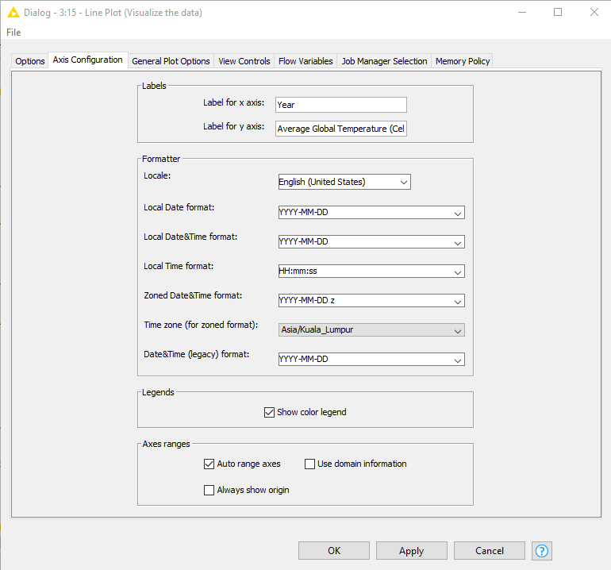

3. Data Visualization
Line Plot - A line plot using a JavaScript based charting library.

Slide 40
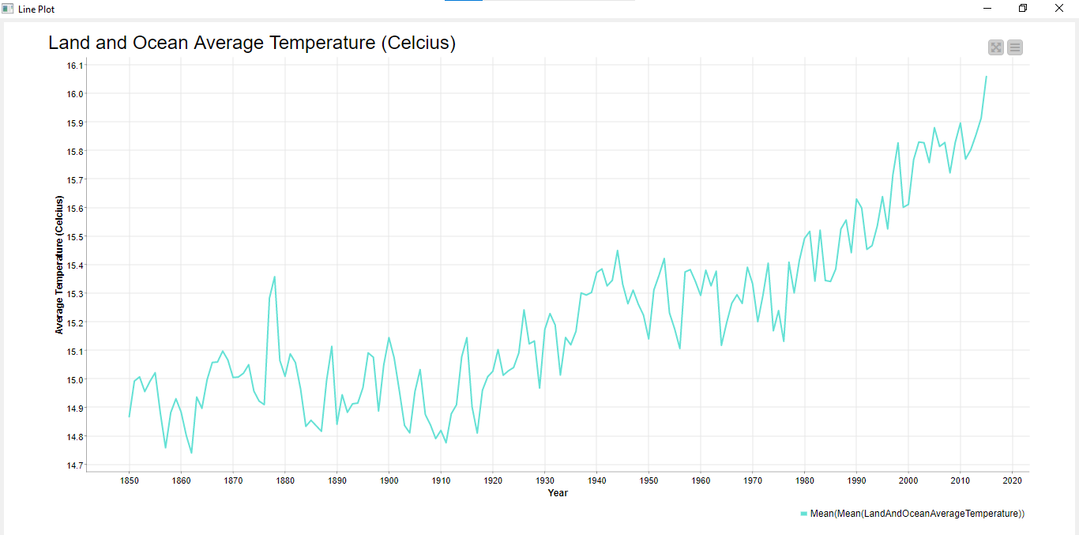
From the line chart, we can observe the pattern and trend of the global temperature. We know that climate change indicator is measured from earth surface temperature.
This line chart indicates that the global land and ocean average temperature has fluctuated trend but keep increasing from the data retrieved (1750 to 2015)
This can be concluded that, the earth surface temperature keep increasing and we are actually facing global warming
Notes:
Reading links: https://www.carbonbrief.org/guest-post-why-does-land-warm-up-faster-than-the-oceans/

Slide 41
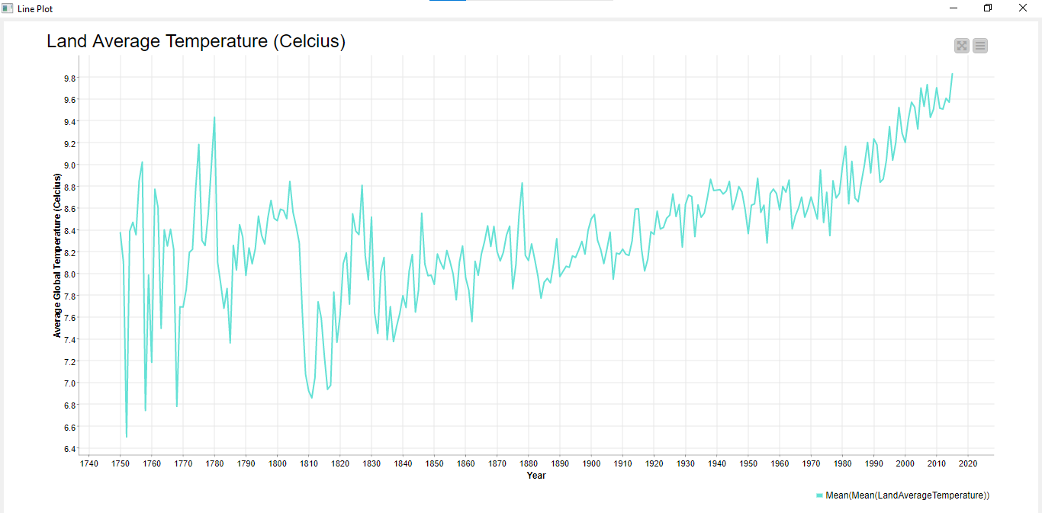
From the line chart, we can observe the pattern and trend of the global temperature. We know that climate change indicator is measured from earth surface temperature.
This line chart indicates that the global land average temperature has fluctuated trend but keep increasing from the data retrieved (1750 to 2015)
This can be concluded that, the earth surface temperature keep increasing and we are actually facing global warming
Notes:
Reading links: https://www.carbonbrief.org/guest-post-why-does-land-warm-up-faster-than-the-oceans/

Slide 42
Exercises
By doing your own interpretation, use the other datasets from this kaggle website to exercise EDA. Then, discuss it.

